Slide 1
Project 2
Presentation
Maze Router
By : Salma Ahmed 900171008
Mark George 900183231
Abdallah Abdelnaby 900171494

Slide 2
Overview
Technical background
Design and implementation aspects
Examples
Problems/Limitations
Conclusions

Slide 3
Technical Background
Lee 19
Lee ‘s Algorithm is a breadth-first search-based solution for maze routing problems.
Pros
It always finds the best answer if one exists.
Cons
It is slow and memory intensive.

Slide 4
Problem Definition
Given source and target pins in same or different layer
Required to find shortest path from the target to the source
 |  | S
 |  |  | T
T
 | T
 |  |  |  | T

Slide 5
Implementation
Algorithm is mainly divided into two main steps:
Filling
Back Propagation

Slide 6
Filling
The process used to assign costs to the different positions in the grid depending on how far from the source.
Restriction layer 1 :
Increment the cost by 1 in horizontal direction
Increment the cost by 10 in the vertical direction
Restriction layer 2:
Increment the cost by 10 in horizontal direction
Increment the cost by 1 in the vertical direction

Slide 7
Filling Algorithm
We have 9 different cases in which source can exist
S
 | S
 | S
 | S
S
Left top edge
Right bottom edge
Right top edge
Left bottom edge
Middle
 | S
S
 | S
 | S
Left edge
Right edge
Top Edge
Bottom Edge

Slide 8
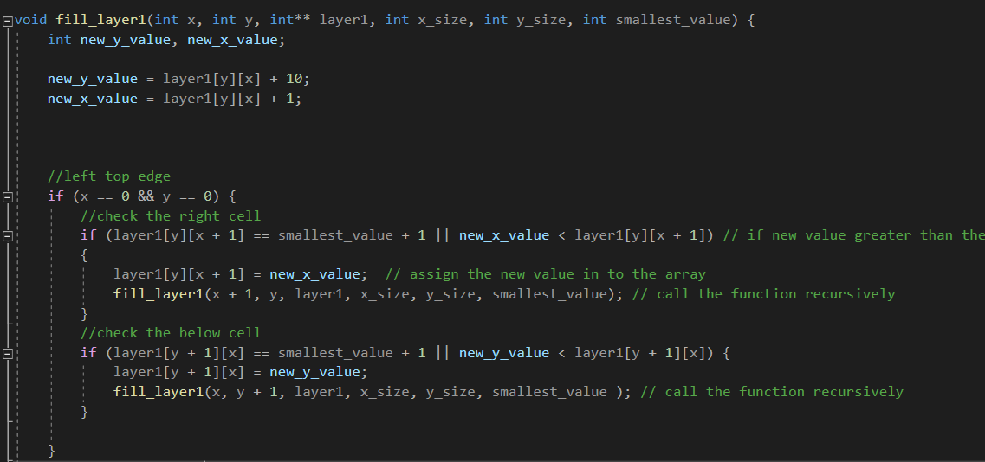
Filling Code
The process of filling is done using the function fill layer which takes the x value of the source, y-value of the source, grid and size of the grid.
Using if conditions it identifies in which case does the source exists.
Accordingly it fills it neighbours
The function is called recursively for the neighbouring cells to fill the grid

Slide 9
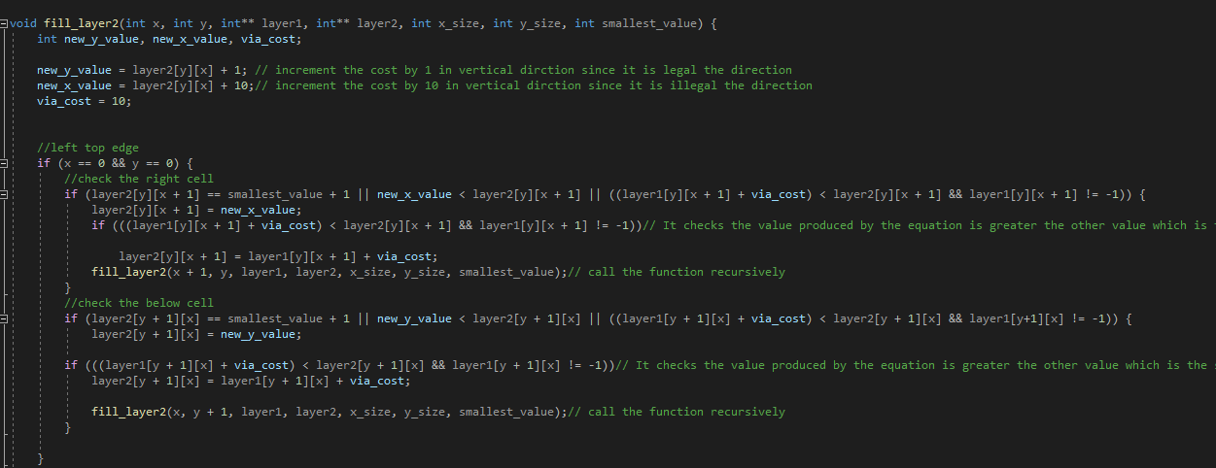
Filling Second Layer
Filling Second Layer is done by a function fill_layer2
The function also uses if conditions to identify in which case does the source exists.
It compares the value produced by the equation and the other value which is the sum of the fill cost of layer below + via cost
Assign the cell with the minimum cost
The function is called recursively to fill the whole grid

Slide 10
Filling Example

Slide 11
Back Propagation
Back Propagation is done by the function back_track which return the path in a vector
Similarly to fill_layer, it identify in which case is the target
Stores the current target cost in variable
Compute the differences between the current target and neighbours and the current target and cell in layer above or below and store the differences in variables
If the neighbour is an obstacle or fill cost is greater than the current cell cost assign very high cost to the difference variable
Else if neighbour value is smaller compute difference between them
It compares the differences computed and according to min value it updates target and the current target cost push the new target into the path vector.
This is repeated until we reach the source

Slide 12
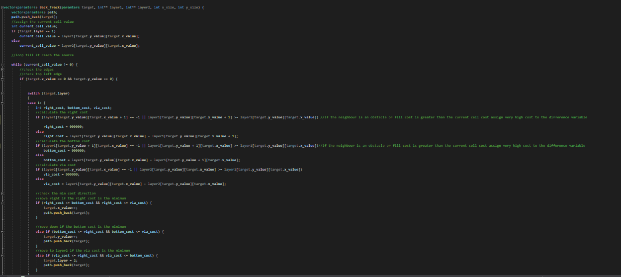
Back Propagation Code

Slide 13
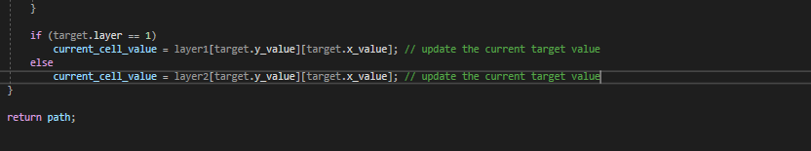
Back Propagation code

Slide 14
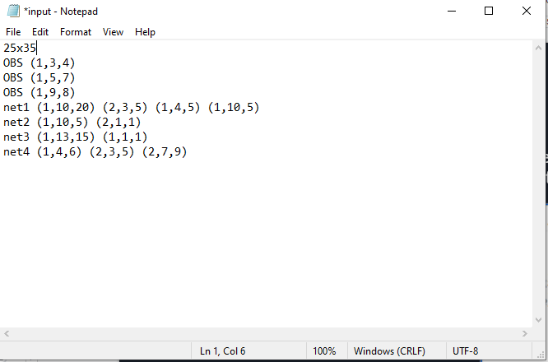
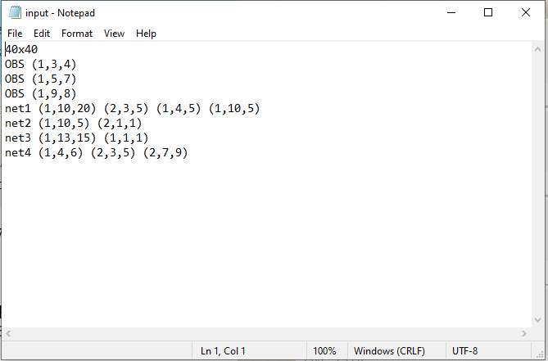
Input
Text File which contains the size of the grid, coordinates of the obstacles and coordinates of the nets to be connected.

Slide 15
Procedure
We read the parameters from the text file and store obstacles and nets in vectors.
We use nested for loops to loop over the nets stored in 2d struct vector.
We take the first net in the row as source and the rest of the points in the row as targets.
Initialize layer 1 by 1 and layer 2 by 11
Assign -1 where the obstacles is placed.
Call fill_layer 1 and fill _layer_2 to fill the two grids

Slide 16
Procedure
Call the function back tack to find the path from target to the nearest source in the previous path
Reinitialize layer 1 by 1 and layer 2 by 11
Fill the obstacles with -1
Fill all the points in the path with 0
Push sub path of every two nets connected in the same row into the vector full path
Call fill layer function for the two layers
Continue to loop over nets in the same row to find sub path and push it to full path vector until last net in the row
Then push it to 2d vector
Repeat the same procedure with all rows

Slide 17
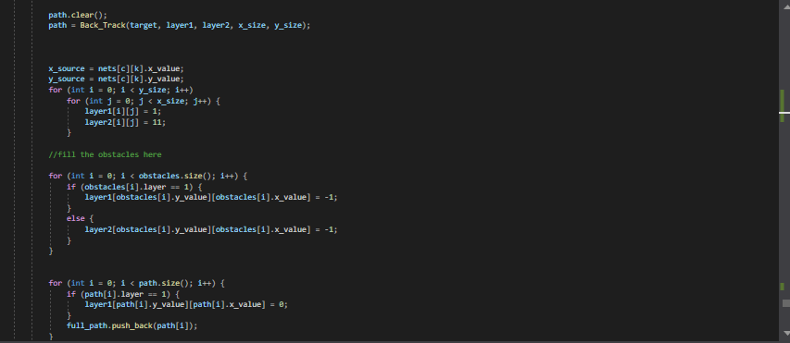
Code

Slide 18
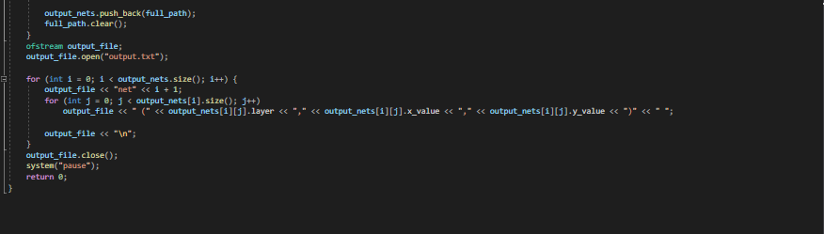
Code

Slide 19
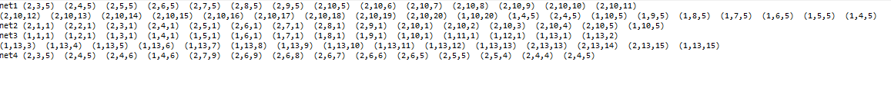

Output
Output 25 x 35
Output 40 x 40

Slide 20
Visualization

Slide 21
Limitation
When running large sizes on visual studio it crashes as our code algorithm has a complexity of n^3 log(n)

Slide 22
Conclusion
The algorithm declares two layers grid
Sources are initialized to 0 and obstacles are initialized to -1
The algorithm recursively fill layer1 then layer2
Then the algorithm loop on the target pins and backtrack to the source producing a path
The path is then initialized to 0 and is considered source points
The algorithm keeps looping and connecting the target points with shortest point on the path

